Slide 1
Turtle: Introduction

Slide 2
The turtle Library is primarily designed to introduce children to the world of programming. With the help of Turtle's library, new programmers can get an idea of how we can do programming with Python in a fun and interactive way.

Slide 3
Getting started with turtle
The turtle is built in library so we don't need to install separately. We just need to import the library into our Python environment.

Slide 4
Getting started with turtle
The Python turtle library consists of all important methods and functions that we will need to create our designs and images

Slide 5
Importing the turtle module
Import the turtle library using the following command.
import turtle

Slide 6
After Importing Turtle
Now, we can access all methods and functions. First, we need to create a dedicated window where we carry out each drawing command. We can do it by initializing a variable for it.

Slide 7
Creating a screen with Turtle
s = turtle.getscreen()

Slide 8
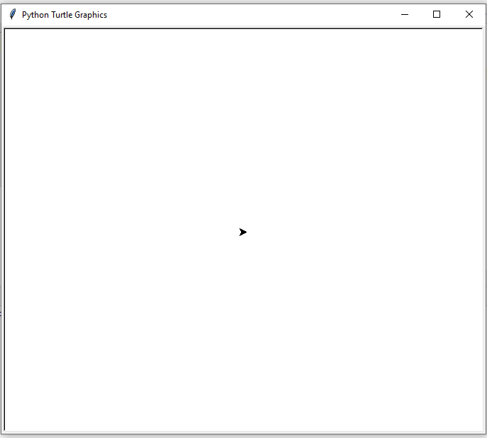
Output

Slide 9
Creating a Turtle
bob = turtle.Turtle()

Slide 10
Output

Slide 11
Turtle Motion
First, we need to learn to move the turtle all direction as we want. We can customize the pen like turtle and its environment. Let's learn the couple of commands to perform a few specific tasks.
Turtle can be moved in four directions.

Slide 12
Motion Functions
right
left
forward
backward

Slide 13
Distance ->Functions
forward(distance)
backward(distance)

Slide 14
Angle-> Functions
right(angle)
left(angle)

Slide 15
Angles
The angle is the amount of turn between each arm.

Slide 16
Angles
Angles are formed when two lines intersect at a point. The measure of the 'opening' between these two rays is called an 'angle'.

Slide 17
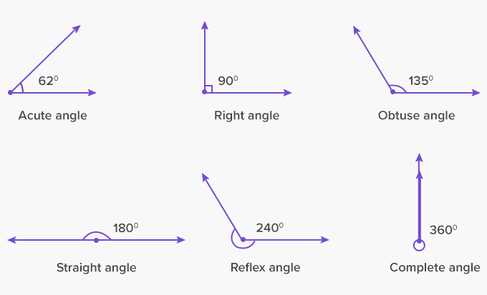
Angles
For more info, visit :https://www.cuemath.com/geometry/angles/

Slide 18
Straight Motion
The turtle can move forward and backward in direction that it's facing. Let's see the following functions

Slide 19
Illustration
To move the turtle forward, when it is headed in a particular direction,
Command:
bob.forward(distance)
bob.forward(100)

Slide 20
Illustration
To move the turtle backward, when it is headed in a particular direction,
Command:
bob.forward(distance)
bob.forward(100)

Slide 21
Distance
The distance as used in the functions, forward and backward are measured in pixels

Slide 22
Screen Dimension
Each screen has a dimension/ resolution
This dimension is usually measured in pixels

Slide 23
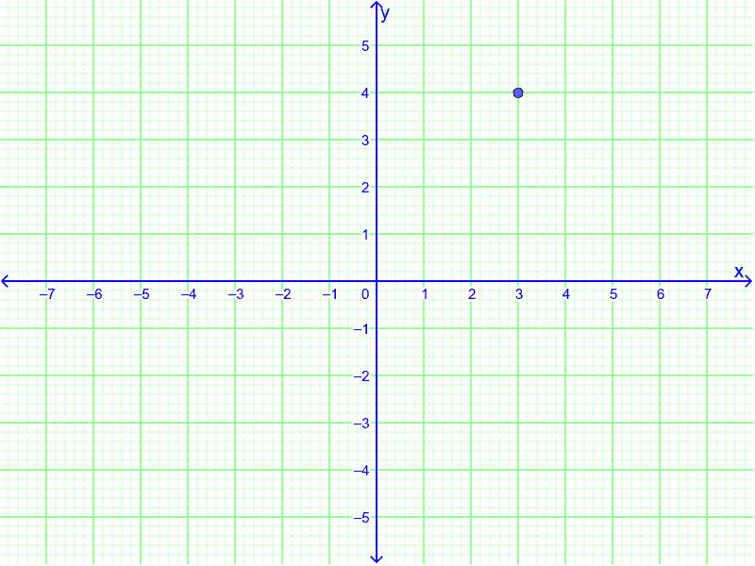
Screen Dimension

Slide 24
Screen Dimension
Vertical window length
Horizontal window length

Slide 25
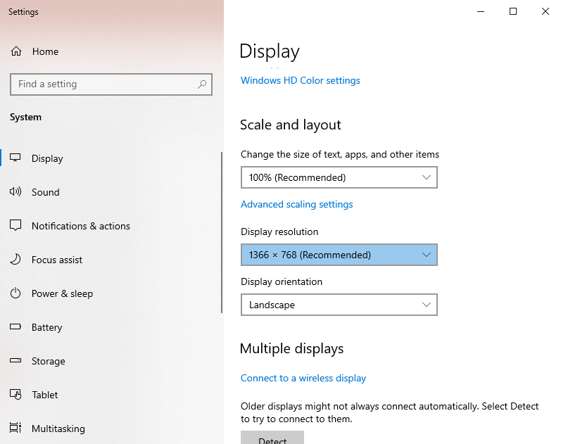
My Screen Size/Dimension

Slide 26
Precaution
Always maximize your window while your program is running

Slide 27
forward
forward(distance) or turtle.fd(distance) - It moves the turtle in the forward direction by a certain distance. It takes one parameter distance, which can be an integer or float.

Slide 28
Illustration
import turtle
# Creating turtle screen
t = turtle.Turtle()
# To stop the screen to display
t.forward(100)
turtle.mainloop()

Slide 29
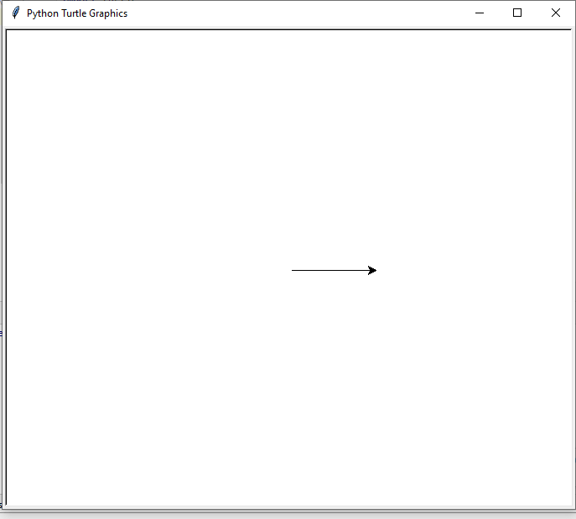
Output

Slide 30
forward
forward(distance) or turtle.fd(distance) - It moves the turtle in the forward direction by a certain distance. It takes one parameter distance, which can be an integer or float.

Slide 31
Illustration
import turtle
# Creating turtle screen
t = turtle.Turtle()
# Move turtle in opposite direction
t.backward(100)
# To stop the screen to display
turtle.mainloop()

Slide 32
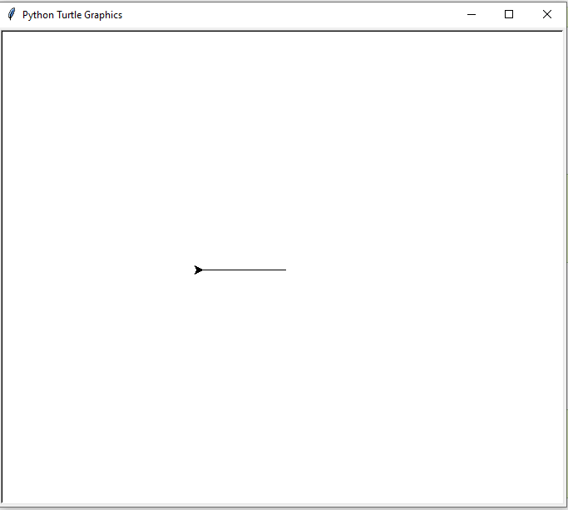
Output

Slide 33
forward
right(angle) or turtle.rt(angle) - This method moves the turtle right by angle units.

Slide 34
right
import turtle
# Creating turtle screen
t = turtle.Turtle()
t.heading()
# Move turtle in opposite direction
t.right(25)
t.heading()
# To stop the screen to display
turtle.mainloop()

